Slide 1

BANK LOAN CASE STUDY
Varunika Naini

Slide 2


Agenda
PROJECT DESCRIPTION
APPROACH
TECH – STACK USED
INSIGHTS
RESULTS

Slide 3

Project Description
As a data analyst at a finance company that provides urban loans, I faced the challenge of dealing with customers with insufficient credit history who default on their loans.
Using Exploratory Data Analysis (EDA), I delved into our loan application data to spot patterns and ensure capable applicants aren't unfairly rejected.
The company risks losing business from good applicants who aren't approved and suffering financial losses from those who can't repay.
By examining customer and loan attributes, I aimed to identify factors that predict default.
This analysis helps us make smarter loan approval decisions, like denying high-risk applicants, adjusting loan amounts, or raising interest rates for risky customers.

Slide 4
Approach
1. Data Collection and Cleaning :
Gather relevant loan application data.
Handle missing values and inconsistencies, encode categorical variables.
2. Exploratory Data Analysis (EDA) :
Descriptive Statistics: Summarize key variables.
Data Visualization: Use histograms, box plots, scatter plots.
Correlation Analysis : Identify significant relationships.
3. Identify Patterns :
Payment Difficulties : Compare customers with and without payment issues.
Outcome Analysis : Analyze trends in Approved, Cancelled, Refused, and Unused Offer cases.
4. Feature Engineering :
Create new predictive features like debt-to-income ratio and loan-to-value ratio.

Slide 5

5. Model Building :
Develop and evaluate predictive models (e.g., logistic regression, decision trees).
Use accuracy, precision, recall, and ROC-AUC for evaluation.
6. Risk Assessment :
Classify customers into risk categories based on model predictions.
Recommend actions: deny, reduce loan amount, or increase interest rate for high-risk applicants.
7. Implementation and Monitoring:
Integrate the model into the loan approval process.
Continuously monitor and update the model with new data.
By following this streamlined approach, I aimed to enhance loan approval decisions, reduce financial risks, and avoid losing business from creditworthy customers.

Slide 6


Tech–Stack Used
In this project, I used Microsoft Excel to handle the entire analysis. I started by importing and cleaning the loan application data, utilizing Excel’s filtering, sorting, and data validation features.
For exploratory data analysis (EDA), I used Excel formulas, pivot tables, and charts to uncover patterns and relationships in the data. I also engineered new features with Excel functions to better predict loan defaults.
To assess risk and make decisions, I employed Excel's Solver and What-If Analysis tools. Finally, I created interactive dashboards and used conditional formatting to clearly present my findings and insights.
Microsoft Powerpoint to make presentation .

Slide 7
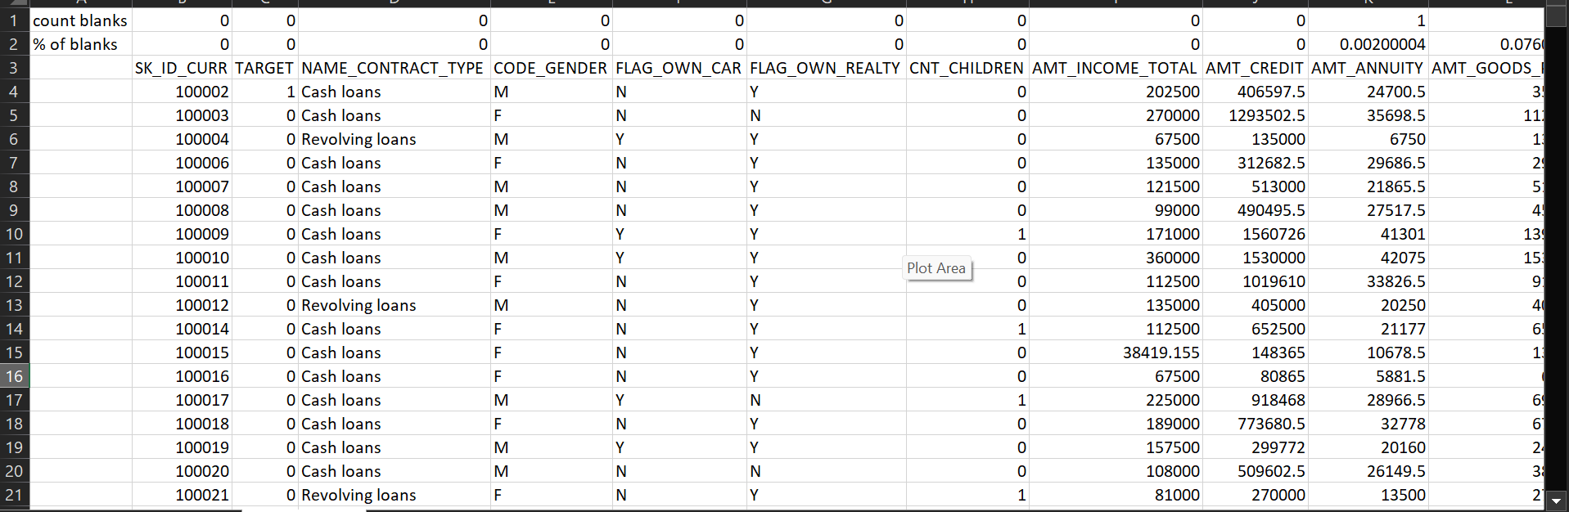
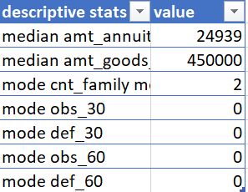
Insights
Question 1 : Identify the missing data in the dataset and decide on an appropriate method to deal with it using Excel built-in functions and features.
Used countblank to calculate no of blanks
And calculated % of blanks and deleted columns having %>35.
Replace blanks in AMT_ANNUITY with median value = 24939.
Replace blanks in Name type suite with mode = “Unaccompanied”.
Replace occupation type with mode = “laborers”.

Slide 8
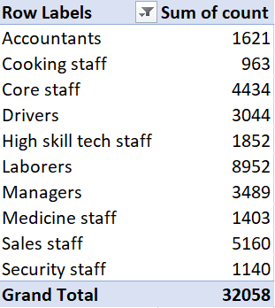
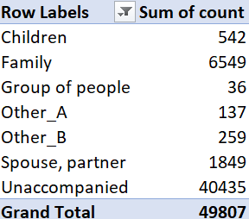
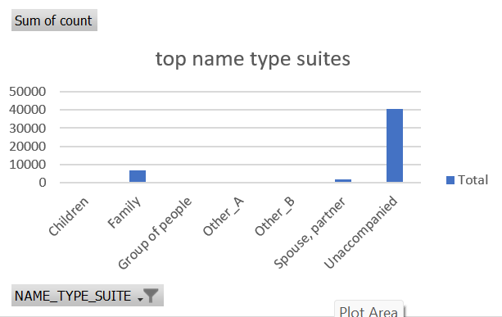
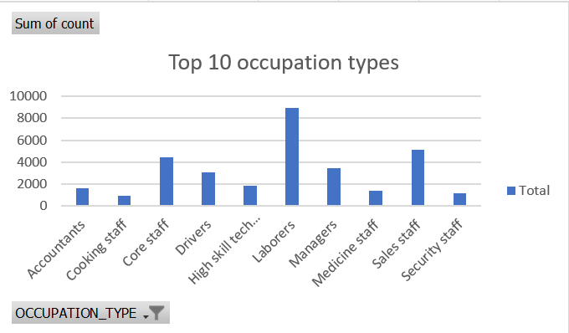
Replace columns obs_30_cnt , def_30_cnt , obs_60_cnt ,def_60_cnt blanks with mode = ‘0’ .
Replace blanks in cnt_fam_members with its mode =‘2’.
Replace blanks in Amt_goods_price with median = ‘450000’.

Slide 9
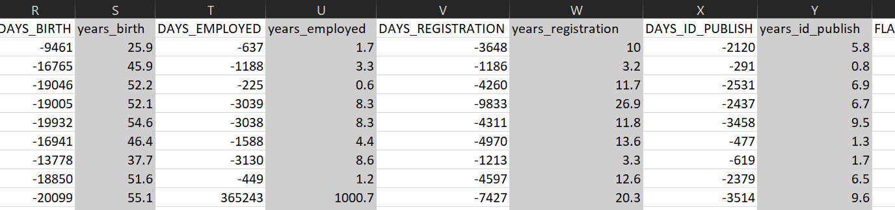
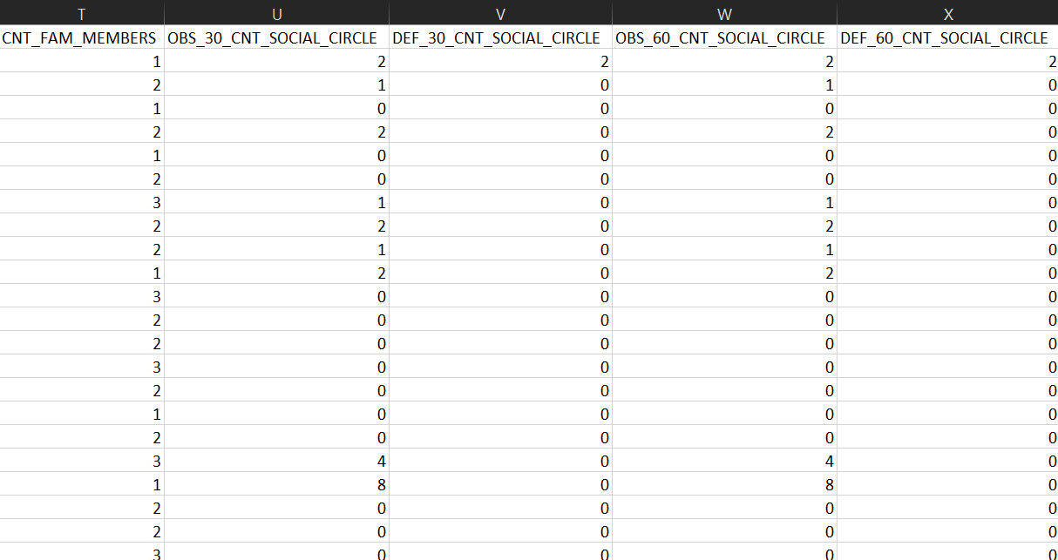
Added 4 more columns using excel formula’s.eg
round(abs(t2/365),1) .
Replace blanks in Organisation type column with mode =
‘business entity type 3’.
Drop unnecessary columns such as flag_own_car , flag_own
_realty , flag_document_2 , etc .
In this way we can clean the data .

Slide 10
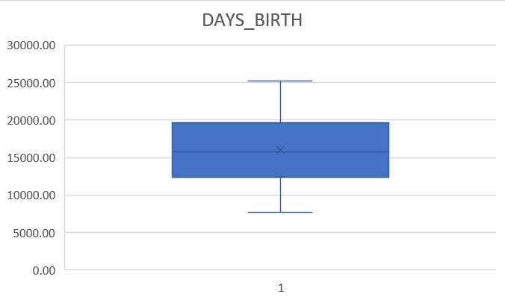
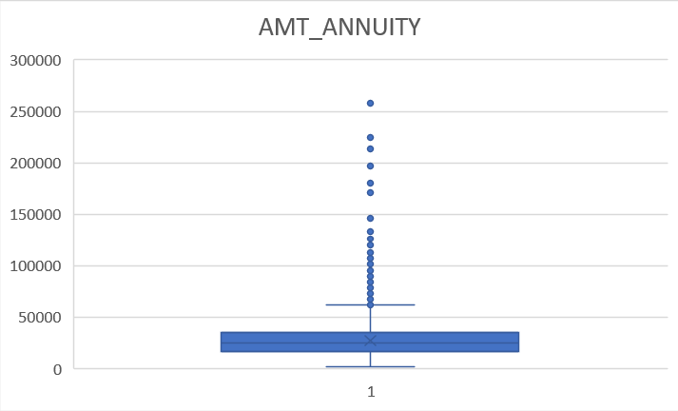
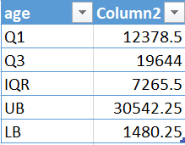
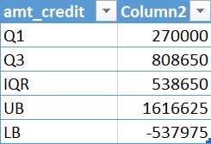
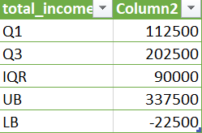
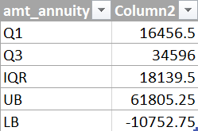
Question 2: Detect and identify outliers in the dataset using Excel statistical functions and features, focusing on numerical variables.

Slide 11
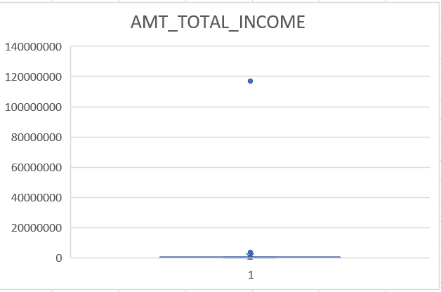
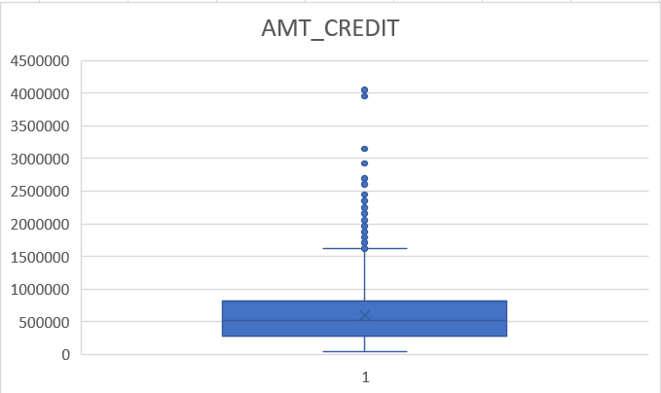
Here we can observe outliers
We are gonna replace the outliers with median ,mode instead of dropping rows
We calculated Quartile 1 , Quartile 3 , IQR , Lower bound and Upper bound using excel functions to determine an Outlier
Eg : OR(b2>UB,b2<LB) .
We observe days_birth doesn’t have an outlier but total_income has an outlier which is possible as different people have different incomes same goes with amt_credit .
Outlier in amt_annuity is replaced by median 24939 .

Slide 12
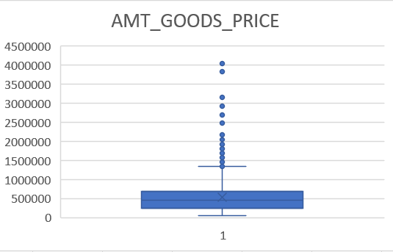
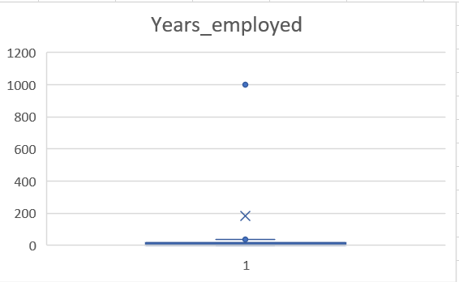
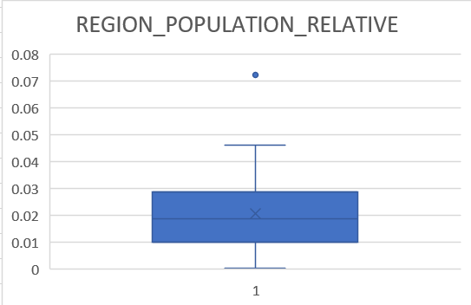
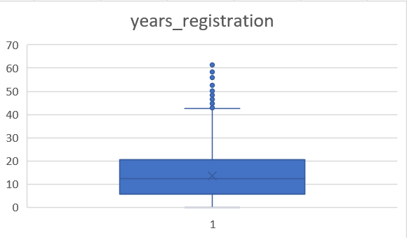

Slide 13
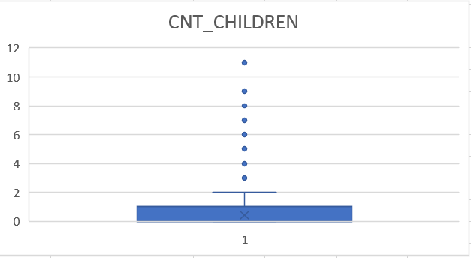
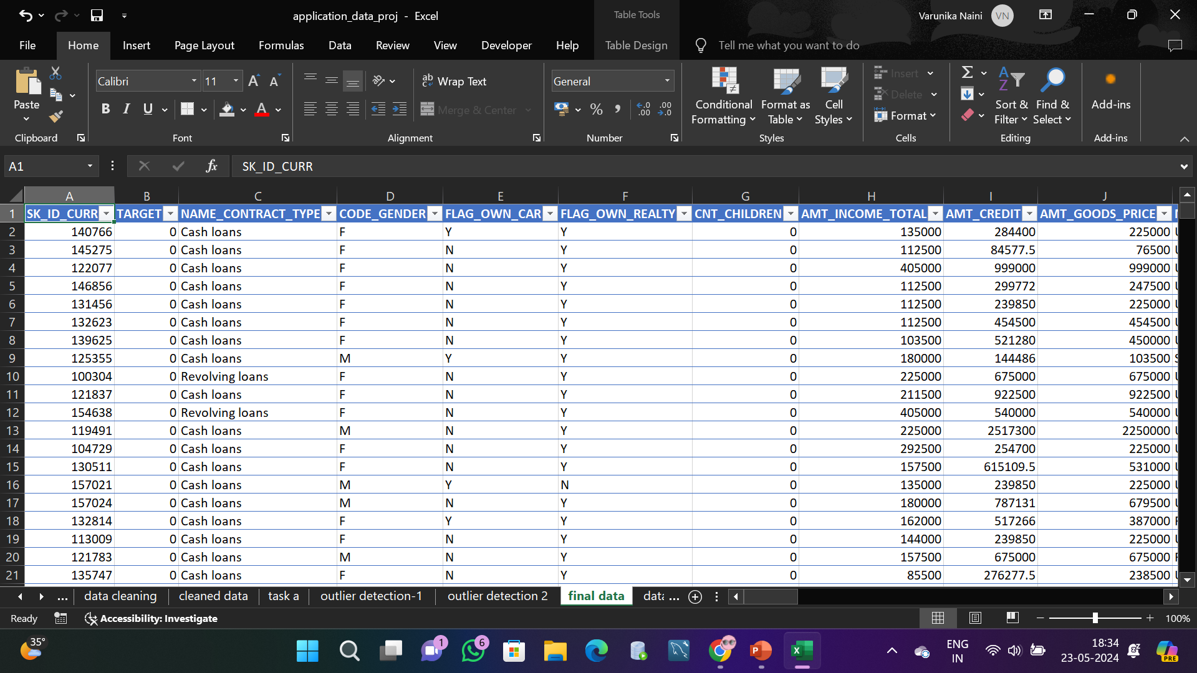
There is an outlier in cnt_children i.e., 11 children which isn’t possible in today’s world .
There is an outlier in years_employed i.e., 1000.7 years which is impossible so we will replace it with median instead of dropping it .
Outlier in region population relative should be replace by median.
Similarly there are outliers in amt_goods price and years_registration which will be left as they are .
After doing the necessary changes , data will be ready for further analysis .

Slide 14
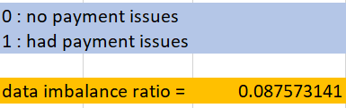
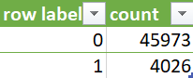
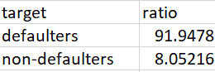
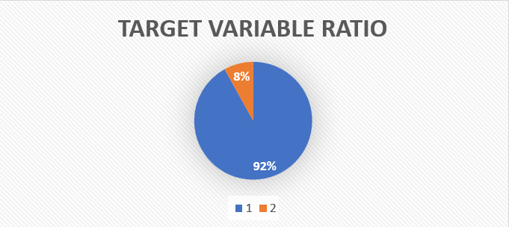
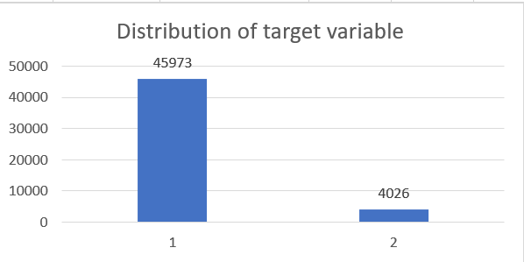
Question 3: Determine if there is data imbalance in the loan application dataset and calculate the ratio of data imbalance using Excel functions.
We can infer that 92% of clients had no issue while doing payments while rest 8% faced some issue regarding payments .

Slide 15
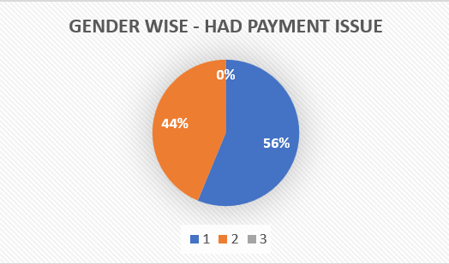
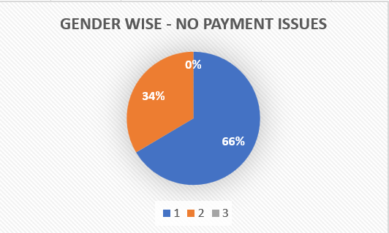
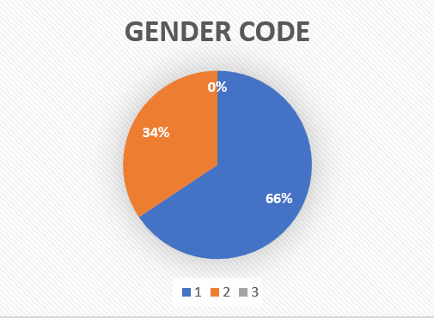
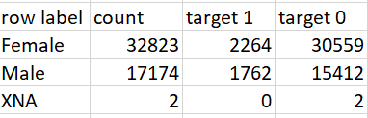
From about pie chart we can observe that 66% clients were male and 34% were female (2 XNA can be ignored).
We can also see that around 2264 females had issue while making payment .

Slide 16
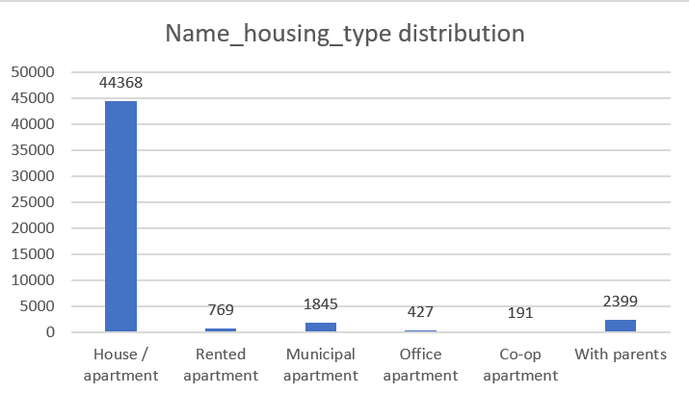
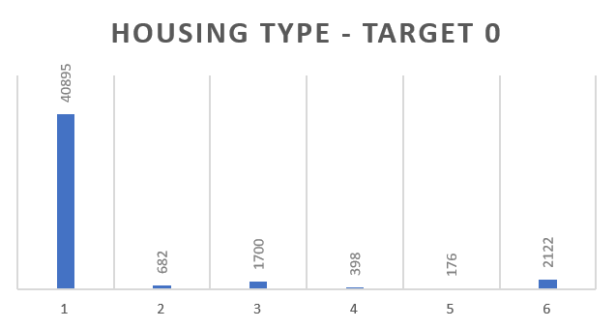
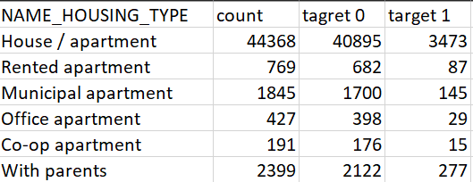
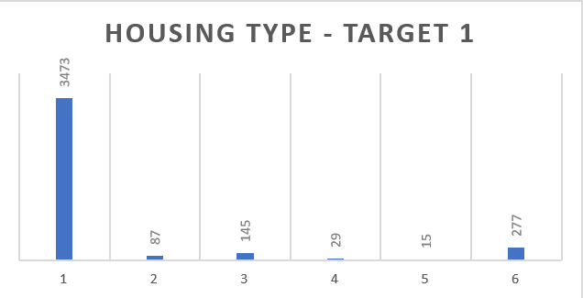
From this we can say that many have house/apartment chances are there bank considers those who live with parents , municipal ,rented apartment and offer loans.

Slide 17
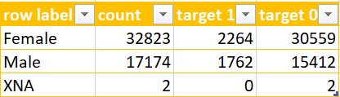
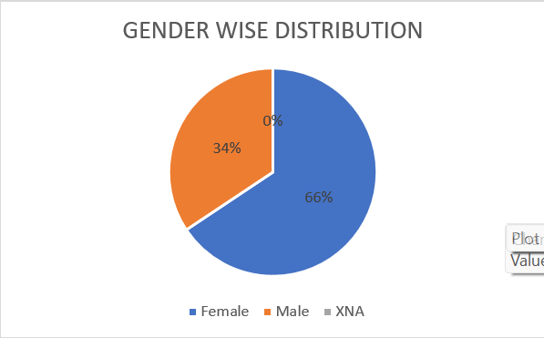
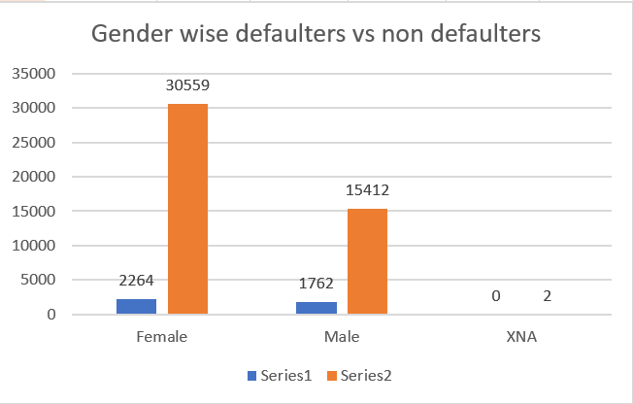
Question 4: ivariate analysis to explore relationships between variables and the target variable using Excel functions and features.Perform univariate analysis to understand the distribution of individual variables, segmented univariate analysis to compare variable distributions for different scenarios, and b
Univariate Analysis
Most Applicants are Female .
Females are most defaulters as well as non defaulters .

Slide 18
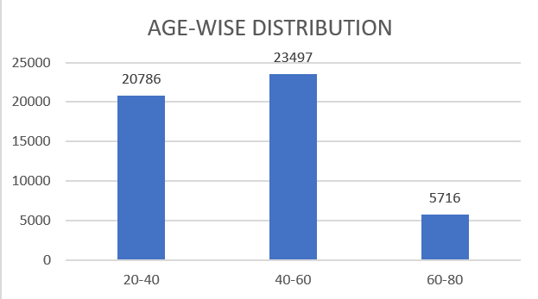
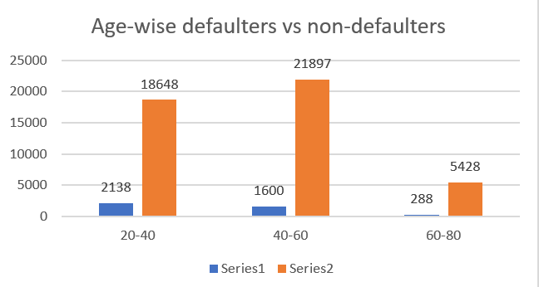
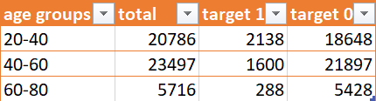
From the bar graph we can see that 40-60 is the age group with highest applicants .
We can also infer that when it comes to defaulters its 20-40 age group
Non defaulters are highest in age group of
40-60.

Slide 19
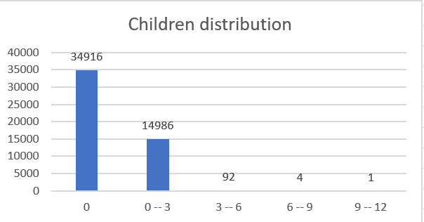
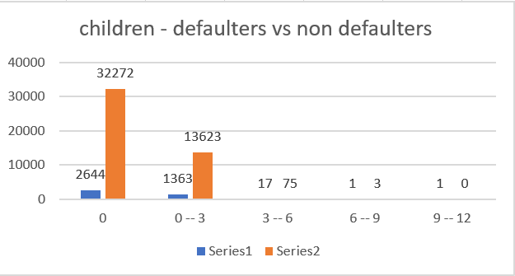
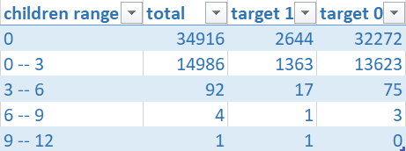
We can see that most of the applicants have 0 children followed by 1-3 children .
Applicants with 0 children are the highest in having payment issues.
Applicants with 0 children are also highest in non-defaulters category i.e., no payment issue.

Slide 20
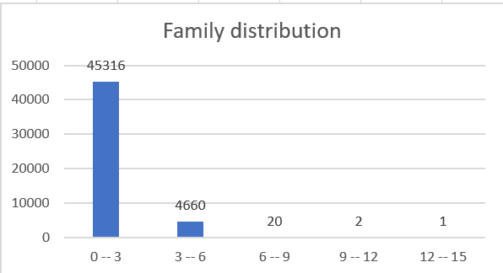
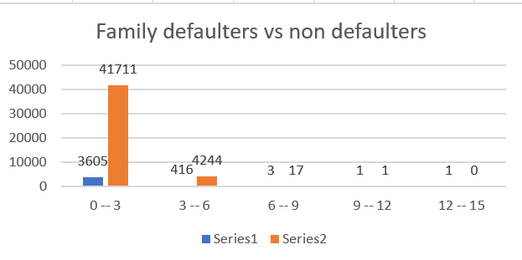
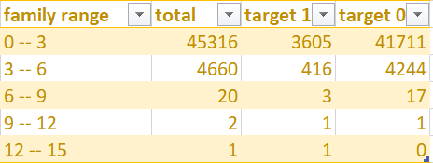
We can see that most of the applicants are a family of 1-3.
Applicants with family size 1-3 are the highest in having payment issues.
Applicants with family size 1-3 are also highest in non-defaulters category i.e., no payment issue.

Slide 21
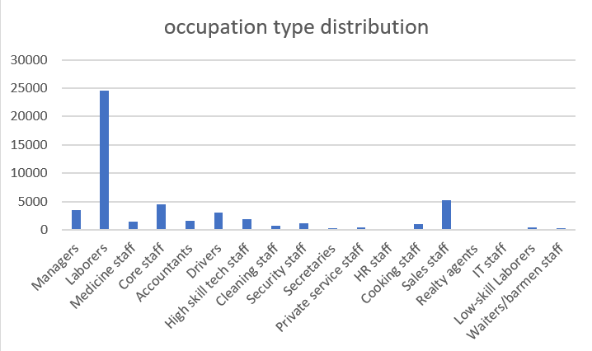
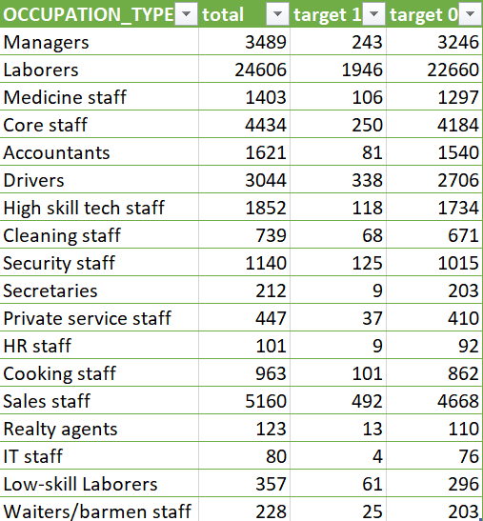
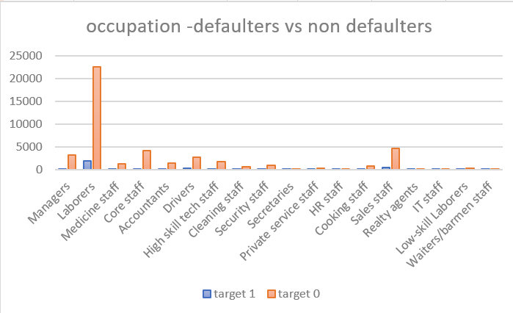
We can see that most of the applicants are laborers .
Laborers are the highest in having payment issues.
Laborers are also highest in non-defaulters category i.e., no payment issue.

Slide 22



We can see that most of the applicants have education type secondary/secondary special .
Applicants with education type secondary /secondary special are the highest in having payment issues And also highest in non-defaulters category i.e., no payment issue.

Slide 23



We can see that most of the applicants have family status civil marriage .
Applicants who have family status married are the highest in having payment issues.
Applicants having status civil marriage are highest in non-defaulters category i.e., no payment issue.

Slide 24



We can see that most of the applicants have a income type of working .
Applicants with income type working are the highest in having payment issues And also highest in non-defaulters category i.e., no payment issue.

Slide 25



Univariate segmented
We can see that most of the applicants are in the range 1L-2L .
Applicants within the range 1L-2L are the highest in having payment issues and also highest in non-defaulters category i.e., no payment issue.

Slide 26



We can see that most of the applicants are in the range 0L-4L .
Applicants within the range 4L-8L are the highest in having payment issues .
Applicants within range 0L-4L are highest in non-defaulters category i.e., no payment issue.

Slide 27



We can see that most of the applicants are in the range 0L-4L .
Applicants within the range 4L-8L are the highest in having payment issues .
Applicants within range 0L-4L are highest in non-defaulters category i.e., no payment issue.

Slide 28



We can see that most of the applicants are in the range 0K – 50K.
Applicants within the range 0K-50K are the highest in having payment issues and also are highest in non-defaulters category i.e., no payment issue.

Slide 29


Bivariate Analysis
We can see that the applicants in range>1000000 have highest credit .
Followed by 9L-10L range

Slide 30


We can see that the applicants in income range>1000000 have highest goods_price .
Followed by 8L-9L range .

Slide 31



For Target 0 : Females are highest in high , low and medium range
For Target 1 : Males are highest in high range and Females are highest in low and medium range .

Slide 32



For Target 0 : secondary/secondary special are highest in high , low and medium range
For Target 1 : secondary/secondary special are highest in high range and Higher education are highest in low and medium range .

Slide 33



For Target 0 : married are highest in high , low and medium range
For Target 1 : married are highest in high , low and medium range .

Slide 34


Question 5 : Correlation coefficient of applicants without payment issues
Correlation coefficient of applicants with payment issues

Slide 35
Previous Application .csv
DATA CLEANING :
We will first start by cleaning data for analysis .
Remove unnecessary columns like HOUR_APPR_PROCESS_START , WEEKDAY_APPR_PROCESS_START_PREV , FLAG_LAST_APPL_PER_CONTRACT , NFLAG_LAST_APPL_IN_DAY ,SK_ID_CURR.
Use COUNTBLANK function to count no of blanks and remove columns having blanks more than 50% .
Drop unnecessary rows like ‘XNA’ , ‘XNP’ for column name type suite .
Replace the blanks in AMT_ANNUITY by its median .
In name_type suite replace the blanks with median =‘Unaccompanied’.
In similar way replace the blanks
OUTLIER DETECTION :
Outlier in AMT_ANNUITY is replaced by median .
No changes in outlier of goods_price , AMT_Application and AMT_credit .
There are no outliers in years_decision .

Slide 36




OUTLIER DETECTION

Slide 37



The following columns are replace with these values for further analysis .
We use mean,median ,mode mostly depending upon the data type .

Slide 38




Univariate and Bivariate Analysis

Slide 39





Slide 40


CONCLUSIONS:
The proportion/percentage of the
defaulters(target = 1) is around 8% and that of non-defaulters(target = 0) is around 92%
The Bank generally lends more loan
Female clients as compared to Males
clients as the count of Female clients in the defaulter’s list is less than that of
Males. Still Bank can look for more Male
clients if their credit amount is satisfied
Also the clients who belong to Working
class tend to pay their loans on time
followed by the clients who fall under Commercial Associate
Clients having Education status like
Secondary/ Higher Secondary or more tend to pay loan on time so bank can prefer lending loans to clients having such Education Status

Slide 41

Result
As a data analyst at a finance company focused on urban loans, I tackled the challenge of customers with insufficient credit history defaulting on their loans.
Using Excel for Exploratory Data Analysis (EDA), I analyzed loan application data to identify patterns and ensure capable applicants aren't rejected. The company faced two main risks: losing business from creditworthy applicants not approved and suffering financial loss from those who can't repay.
By examining customer and loan attributes, I aimed to uncover key factors influencing loan defaults. This analysis helped inform better loan approval decisions, such as denying high-risk applicants, adjusting loan amounts, or increasing interest rates for risky customers.
LINK TO EXCEL SHEET 1
SHEET 2-PREVIOUS_DATA
LINK TO VIDEO PRESENTATION

Slide 42


Thank you
Varunika Naini
varunikaanaini@gmail.com

